Slide 1

DriverPass System Analysis
Mhd Alghazouli

Slide 2

System Requirements
Functional Requirements:
Users can register and log in
Customers can schedule and manage driving lessons
Nonfunctional Requirements
The system must be accessible online (web-based)
The system must protect user data and accounts
Notes:
This system includes both functional and nonfunctional requirements. The functional requirements describe what the system should do. For example, users must be able to create accounts, log in, and schedule driving lessons. These features allow customers to easily interact with the system and manage their learning process.
The nonfunctional requirements focus on how the system performs. The system must be web-based so users can access it from anywhere, and it must protect user information to ensure privacy and security. These requirements help make the system reliable, secure, and easy to use for DriverPass customers and staff.

Slide 3
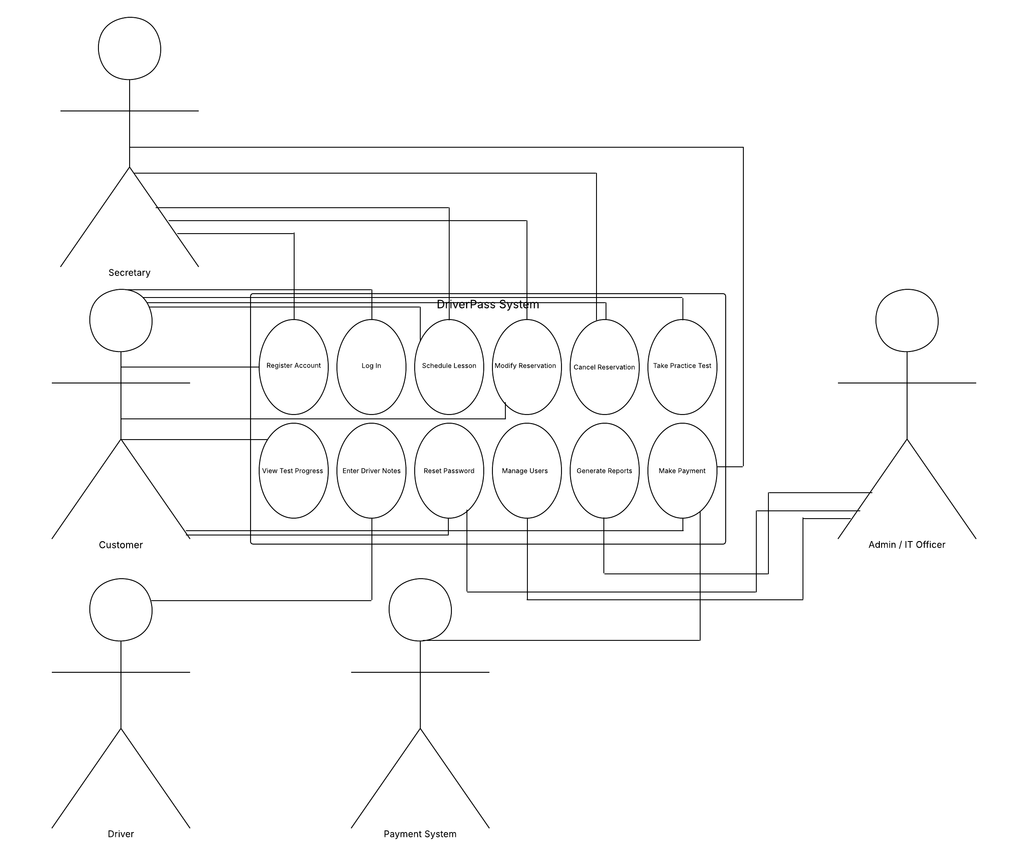
Use Case Diagram
[Insert your use case diagram here.]
Notes:
This diagram shows how different people interact with the DriverPass system. Customers can create accounts, log in, schedule lessons, and take practice tests. Staff members, such as instructors and administrators, have their own responsibilities, like managing users, tracking progress, and generating reports.
This design makes sure that each person has access to the features they need. It helps organize the system clearly and supports both customer activities and business operations.

Slide 4
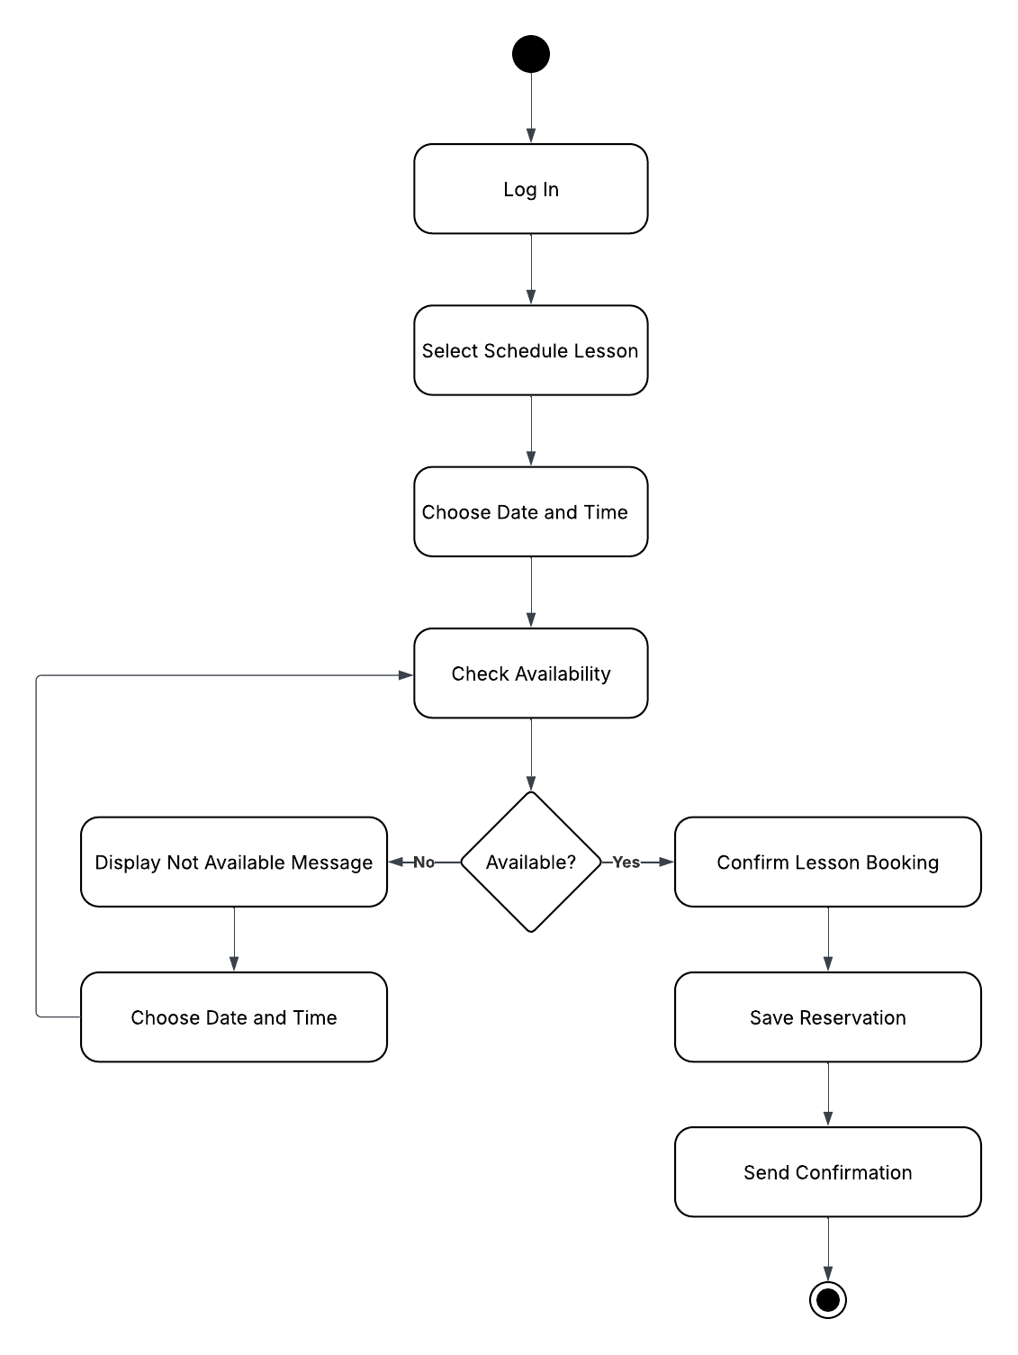
Activity Diagram
[Insert one of your activity diagrams here.]
Notes:
This diagram shows the steps a customer follows to schedule a driving lesson. First, the user logs in and selects the option to schedule a lesson. Then they choose a date and time. The system checks if that time is available.
If the time is not available, the user is asked to choose another time. If it is available, the user confirms the booking, and the system saves the reservation and sends a confirmation.
This process ensures that scheduling is simple and avoids conflicts, which helps improve the customer experience.

Slide 5
Security
Secure user login and passwords
Role-based access (different access for staff and customers)
Protection of personal data
Activity tracking for system actions
Notes:
Security is an important part of the system design. Users must log in with secure credentials to access their accounts. Different users have different levels of access, so customers and staff only see what they need.
The system also protects personal information and tracks important actions, such as bookings and changes. This helps prevent misuse and ensures accountability.
These features help build trust and keep the system safe for all users.

Slide 6
System Limitations
Requires internet connection
Depends on system availability (downtime possible)
Limited to DriverPass services
May require future updates and maintenance
Notes:
While the system provides many useful features, there are some limitations. It requires an internet connection, so users cannot access it offline. The system may also experience downtime for maintenance or updates.
Additionally, the system is designed specifically for DriverPass, so it may need updates in the future to support new features or changes in requirements.
Understanding these limitations helps set realistic expectations and allows for future improvements.

